Slide 1

TUESDAY, APRIL 18, 2017
CROWNE PLAZA EXECUTIVE CENTER
4728 Constitution Avenue Baton Rouge, LA

Slide 2

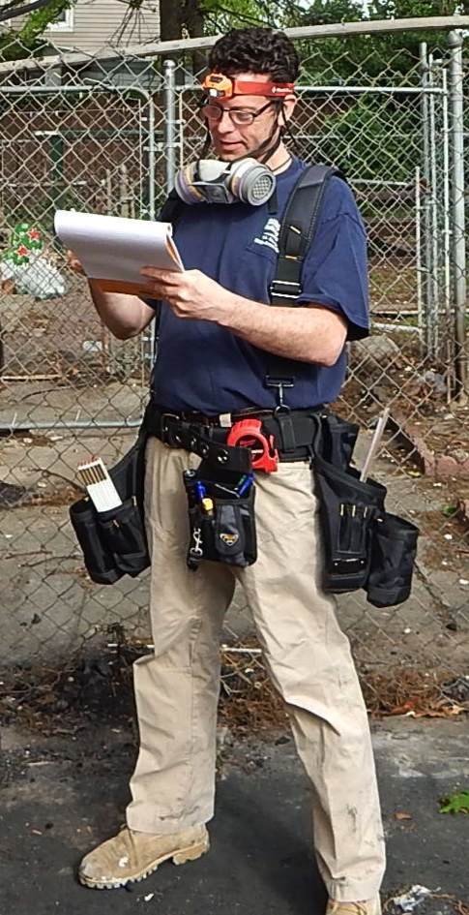




Navigating the Flood Insurance Program
Panelist: Jeffrey S. Major
Ex Carpenter, Builder, GC, CM
Building Damage Estimator
Building Damage Expert
Certified Appraiser
Certified Umpire
Insurance Claims Expert
Certified EIFS Inspector
Insurance Adjuster

Slide 3
Navigating the Flood Insurance Program
Licensed Public Adjuster / Independent Adjuster
Arizona
California
Colorado
Connecticut
Delaware
D.C.
Florida
Georgia
Hawaii
Idaho
Indiana
Iowa
Kansas
Kentucky
Louisiana
Maine
Maryland
Michigan
Minnesota
Mississippi
Montana
Nebraska
Nevada
New Hampshire
New Jersey
New Mexico
New York
North Carolina
North Dakota
Ohio
Oklahoma
Oregon
Rhode Island
South Carolina
Tennessee
Texas
Utah
Vermont
Virginia
Washington
West Virginia
Wyoming
Puerto Rico
Virgin Islands

Slide 4
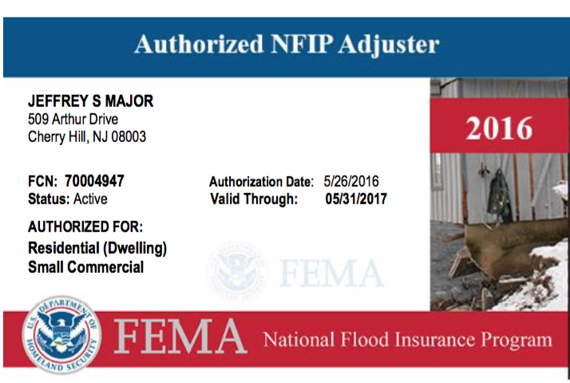
Navigating the Flood Insurance Program
Authorized NFIP Adjuster Through May 31, 2017

Slide 5
Navigating the Flood Insurance Program
Why are flood estimates low?
Adjuster Experience
  Authorized vs. Qualified
Workload
  Quality vs. Quantity
Misuse of Xactimate & Simsol
  Proper line items
Instruction
  FEMA vs. WYO or Independent

Slide 6
Navigating the Flood Insurance Program
14 Systemic Deficiencies 1-7
Gas Lines & Accessories
Sales tax Application
Items Excluded from Overhead and Profit
Remediation and Clean-up
Subflooring
Exterior Sheathing
Steel Brackets, Hangers, Plates and Accessories

Slide 7
Navigating the Flood Insurance Program
14 Systemic Deficiencies 8-14
Room vs. Footprint Measurements
BX vs. Romex
Removal of Dry vs. Wet Building Components
Toilet Related Scope and Line Items
Boiler Related Scope and Line Items
Two Coat Seal and Paint Limitations
Flood Cut vs. Square Foot Drywall Scope

Slide 8
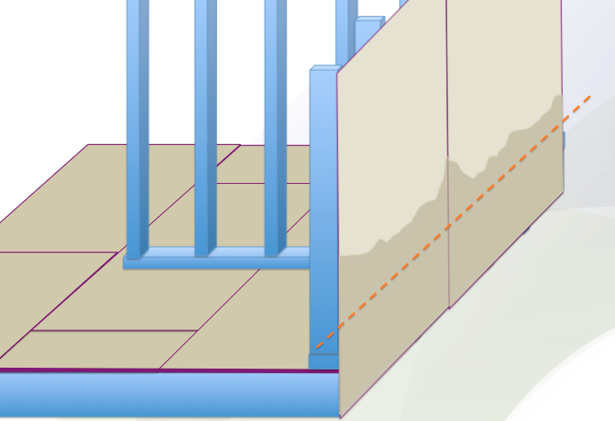
Navigating the Flood Insurance Program
6. Exterior Sheathing

Slide 9
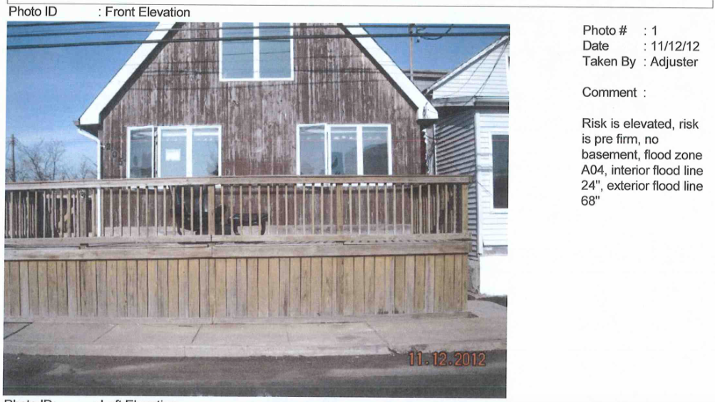
Navigating the Flood Insurance Program
6. Exterior Sheathing

Slide 10
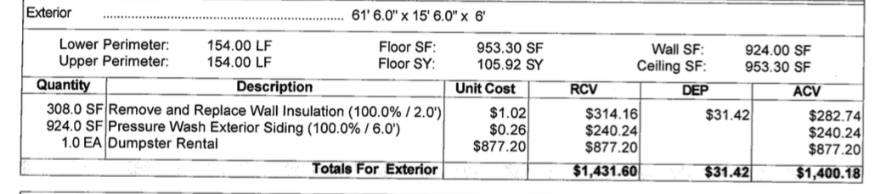
Navigating the Flood Insurance Program
6. Exterior Sheathing

Slide 11
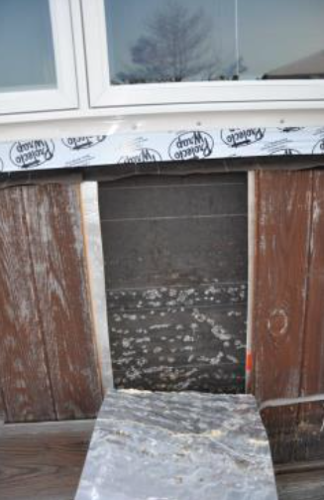
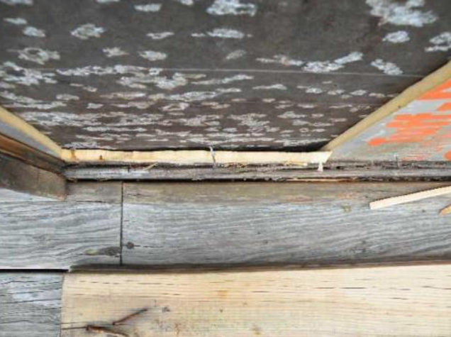
Navigating the Flood Insurance Program
6. Exterior Sheathing

Slide 12
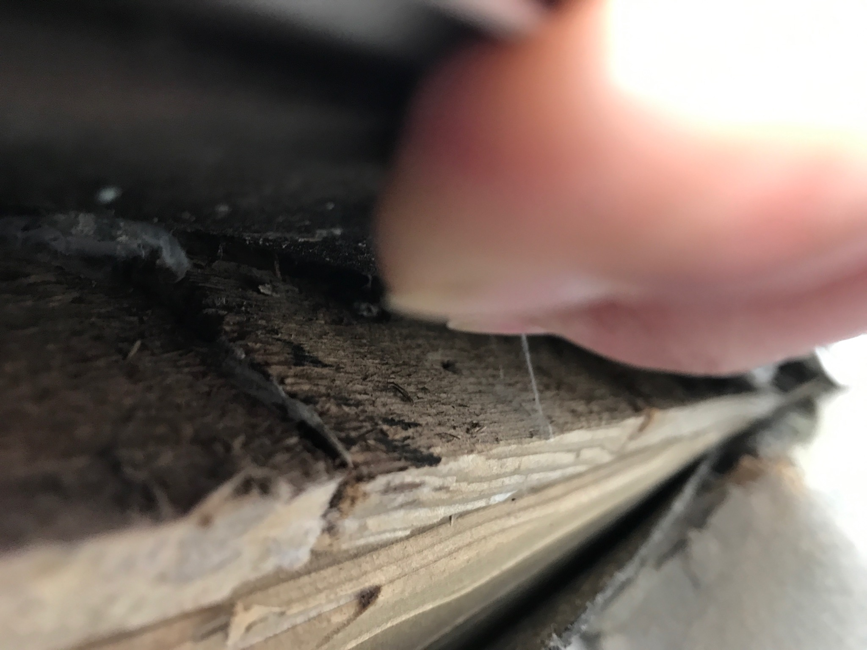
Navigating the Flood Insurance Program
6. Exterior Sheathing

Slide 13
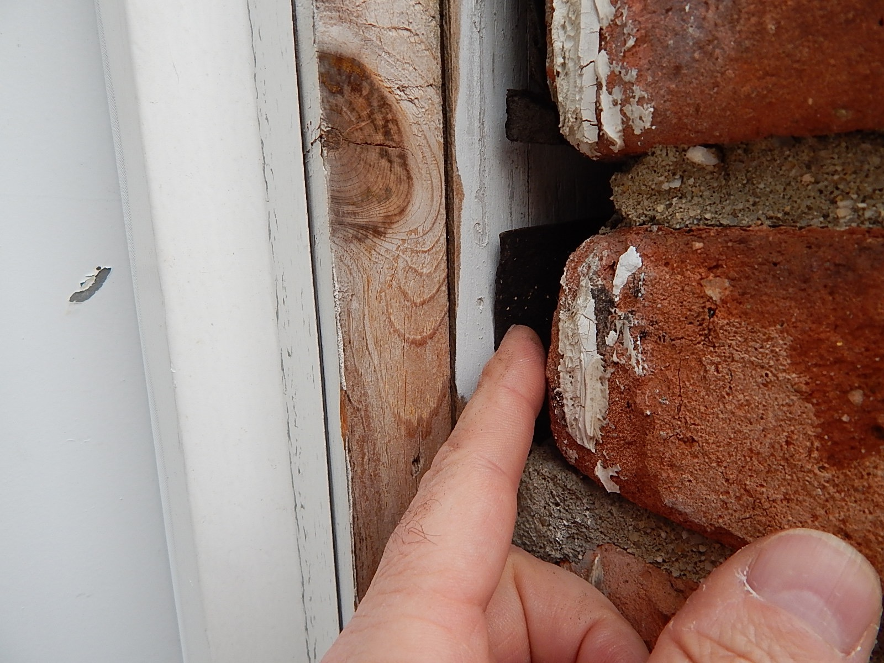
Navigating the Flood Insurance Program
6. Exterior Sheathing

Slide 14
Navigating the Flood Insurance Program
8. Room vs. Footprint Measurements
Drywall
Wall
Framing
Trim
Subfloor
Flooring
up to 6”

Slide 15
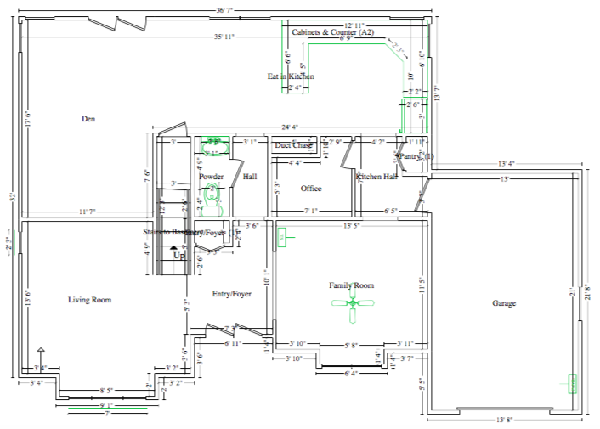
Navigating the Flood Insurance Program
8. Room vs. Footprint Measurements
Individual Room Sf. Totals = 1,304.55

Slide 16
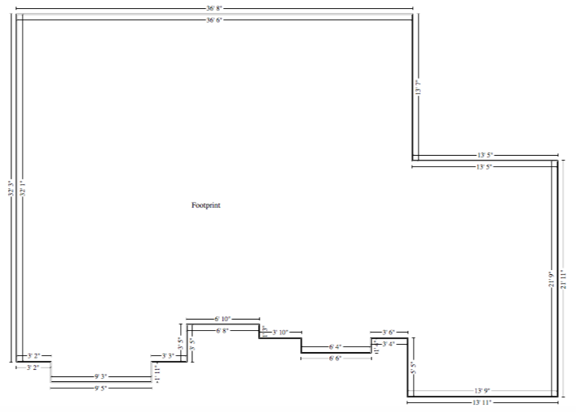
Navigating the Flood Insurance Program
8. Room vs. Footprint Measurements
Footprint Sf. Total = 1,438.18

Slide 17
Navigating the Flood Insurance Program
8. Room vs. Footprint Measurements
Room Sf. vs. Footprint Sf.
  1,305 sf. Individual Rooms
  1,438 sf. Footprint
  133 sf. Missing Scope
  133sf. @ 80/sf. = $10,640

Slide 18
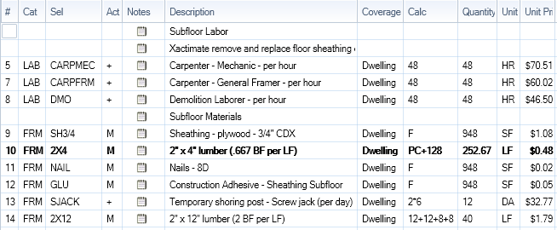
Navigating the Flood Insurance Program
5. Subflooring via 8. Footprint Measurement

Slide 19
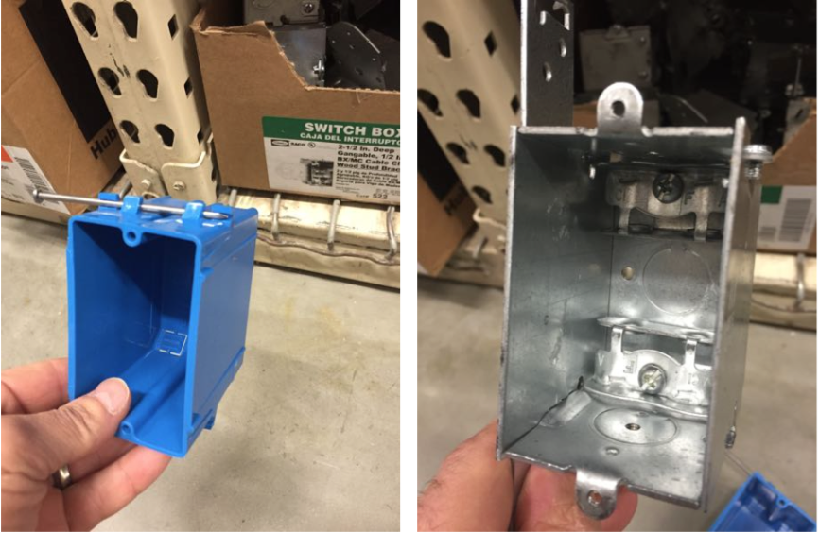
Navigating the Flood Insurance Program
9. BX vs. Romex

Slide 20
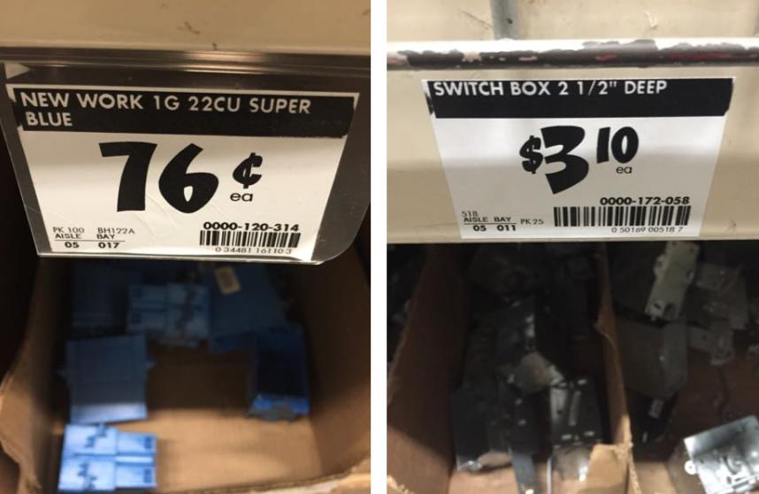
Navigating the Flood Insurance Program
9. BX vs. Romex

Slide 21
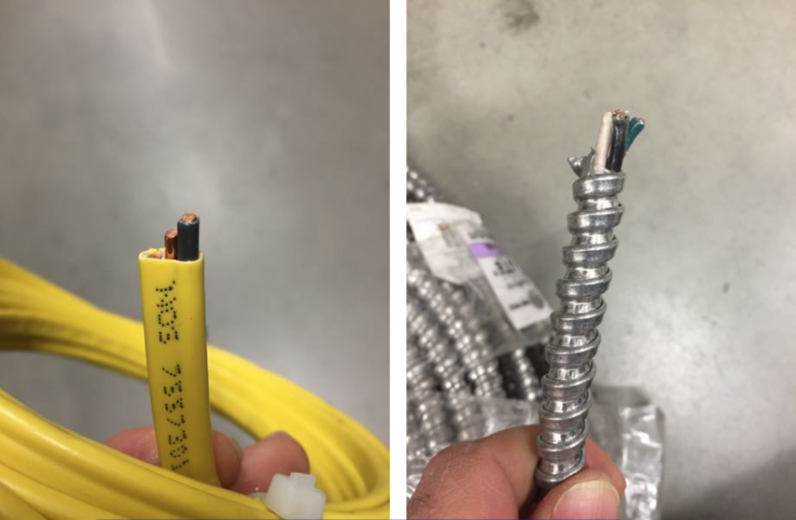
Navigating the Flood Insurance Program
9. BX vs. Romex

Slide 22
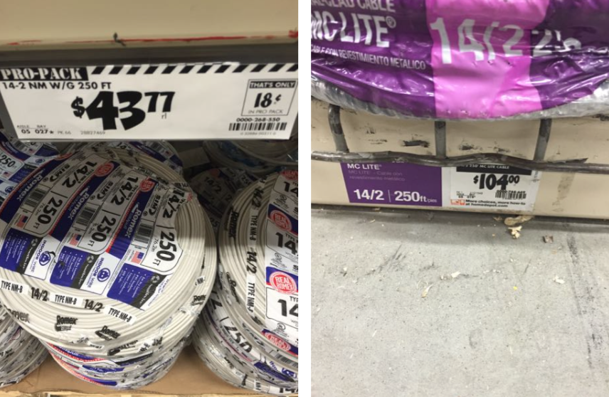
Navigating the Flood Insurance Program
9. BX vs. Romex

Slide 23
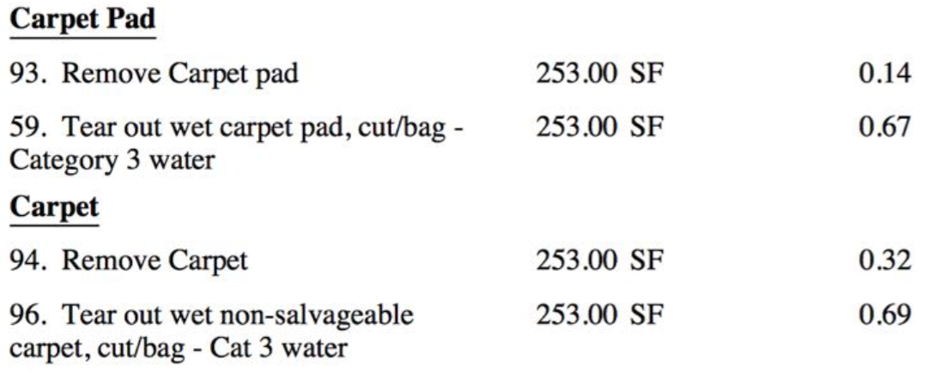
Navigating the Flood Insurance Program
10. Removal of Dry vs. Wet Building Components

Slide 24
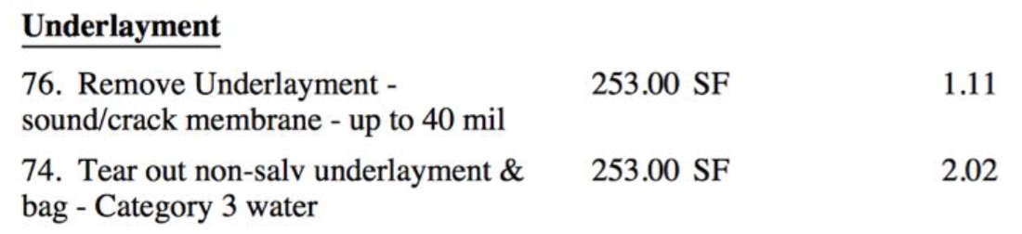
Navigating the Flood Insurance Program
10. Removal of Dry vs. Wet Building Components

Slide 25
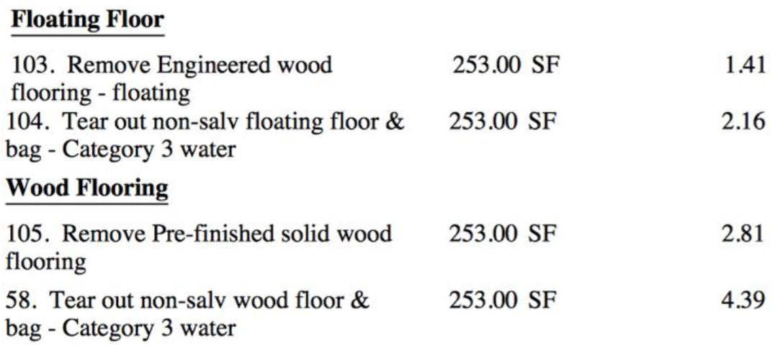
Navigating the Flood Insurance Program
10. Removal of Dry vs. Wet Building Components

Slide 26
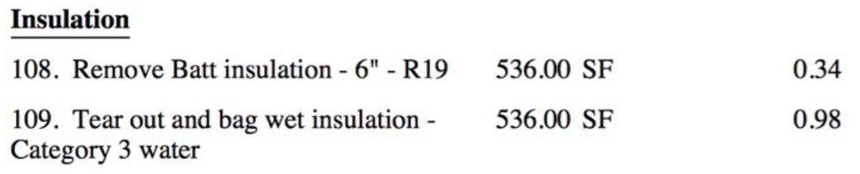
Navigating the Flood Insurance Program
10. Removal of Dry vs. Wet Building Components

Slide 27
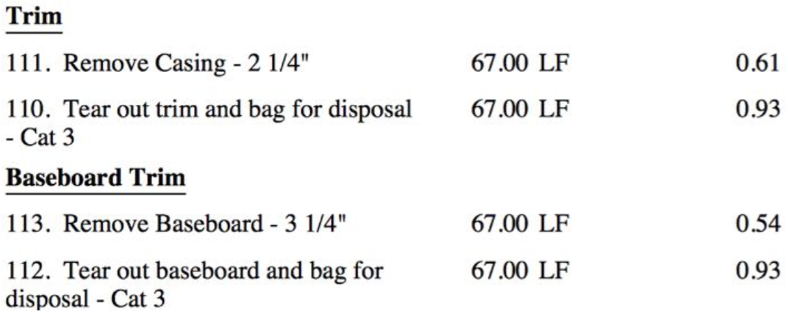
Navigating the Flood Insurance Program
10. Removal of Dry vs. Wet Building Components

Slide 28
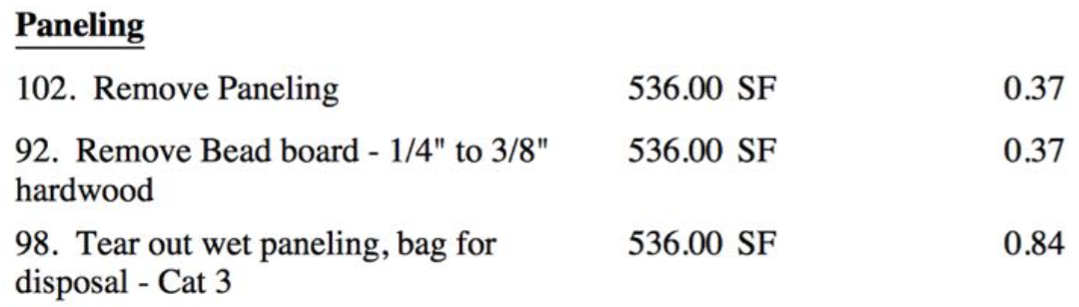
Navigating the Flood Insurance Program
10. Removal of Dry vs. Wet Building Components

Slide 29
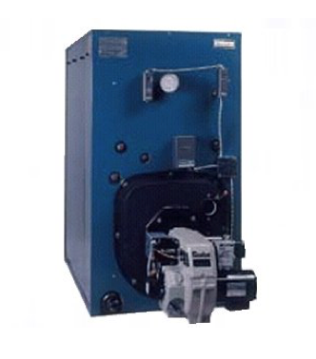
Navigating the Flood Insurance Program
12. Boiler Related Scope and Line Items

Slide 30
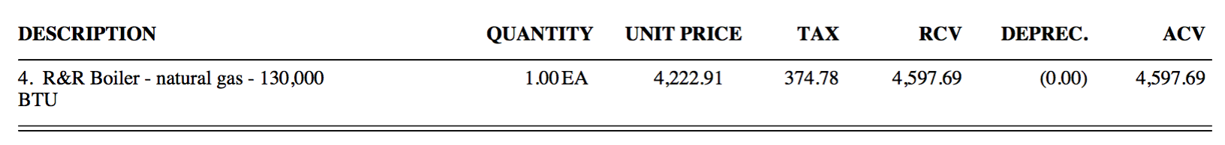
Navigating the Flood Insurance Program
12. Boiler Related Scope and Line Items

Slide 31
Navigating the Flood Insurance Program
12. Boiler Related Scope and Line Items

Slide 32
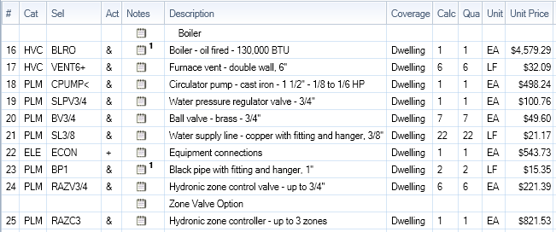
Navigating the Flood Insurance Program
12. Boiler Related Scope and Line Items

Slide 33
Navigating the Flood Insurance Program
14. Flood Cut vs. Square Foot Drywall Scope

Slide 34
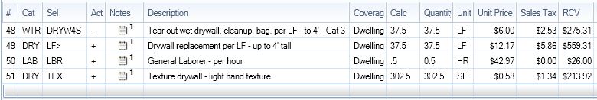
Navigating the Flood Insurance Program
14. Flood Cut vs. Square Foot Drywall Scope

Slide 35
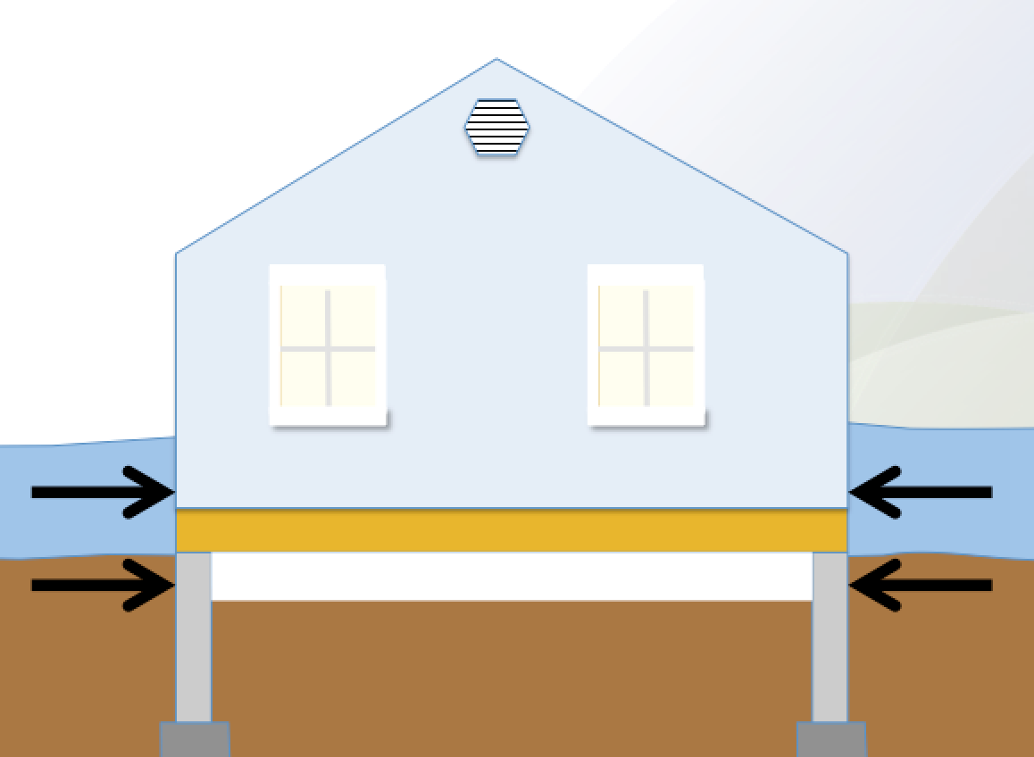
Navigating the Flood Insurance Program
Foundation Damage

Slide 36
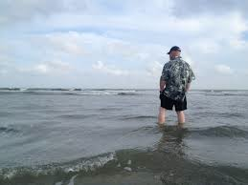
Navigating the Flood Insurance Program
Foundation Damage

Slide 37
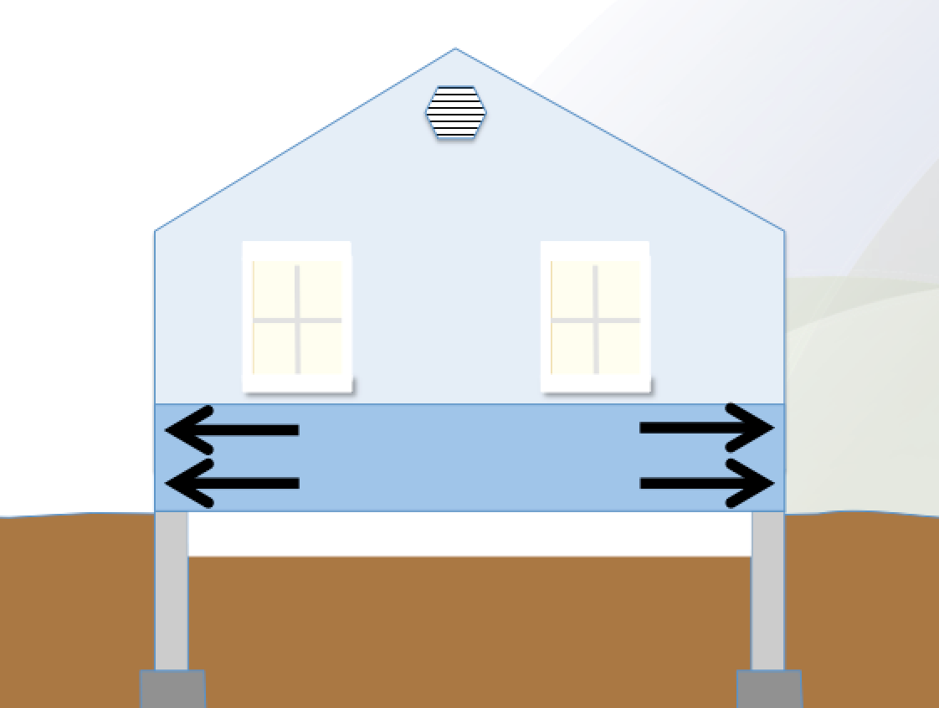
Navigating the Flood Insurance Program
Foundation Damage

Slide 38
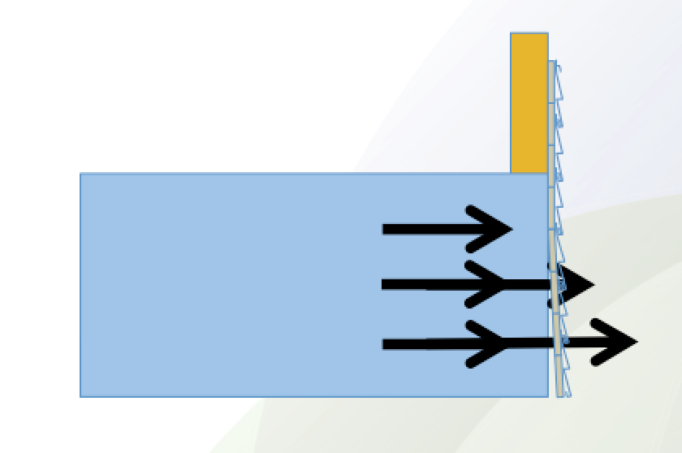
Navigating the Flood Insurance Program
Foundation Damage

Slide 39
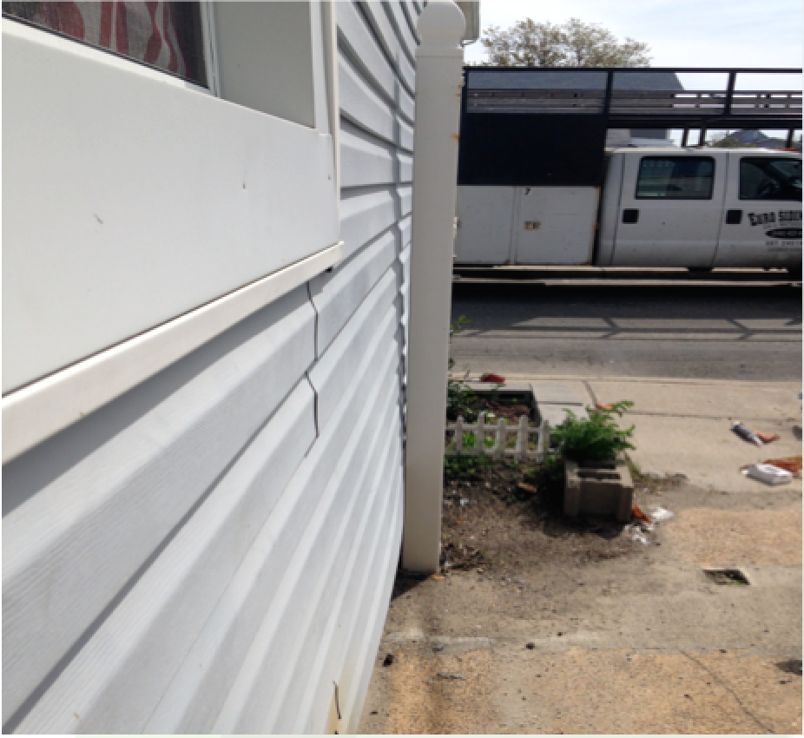
Navigating the Flood Insurance Program
Foundation Damage

Slide 40
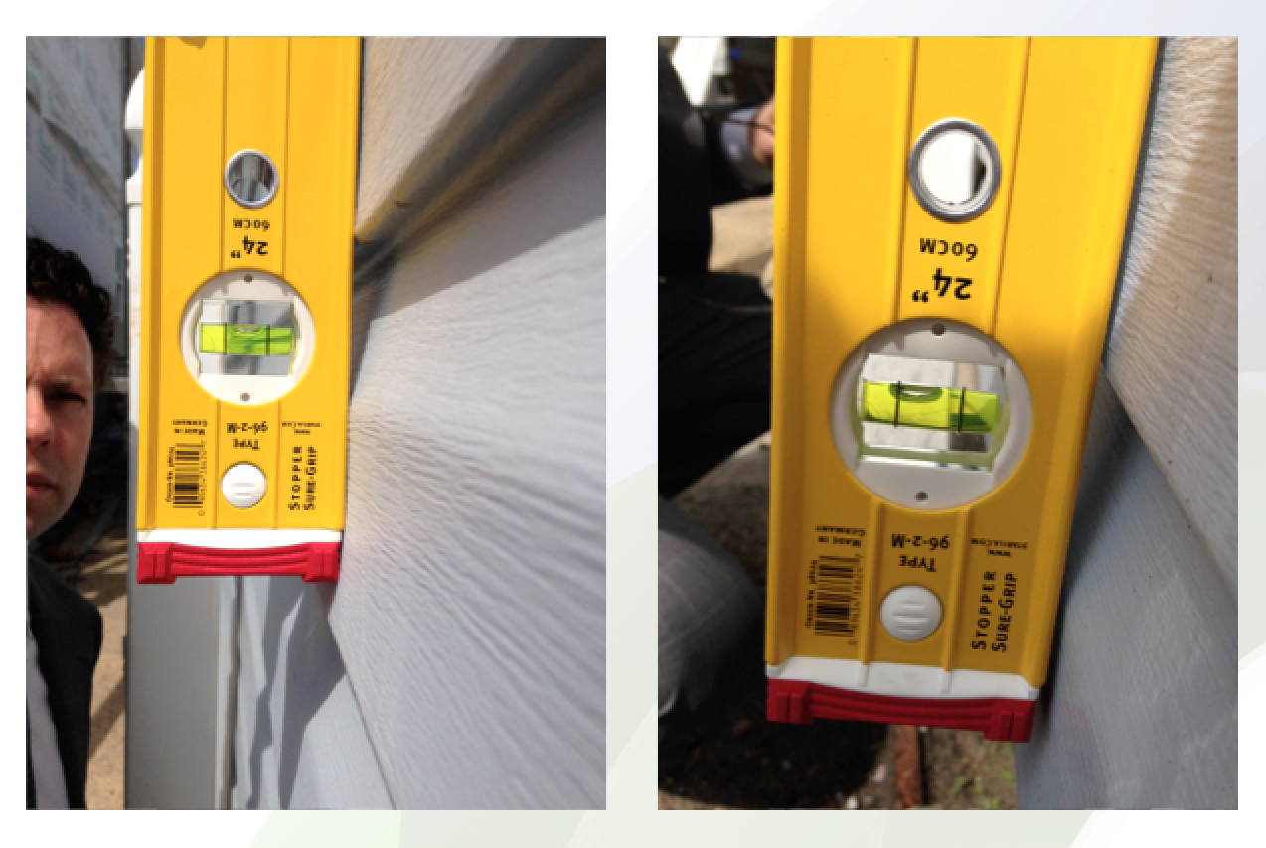
Navigating the Flood Insurance Program
Foundation Damage

Slide 41
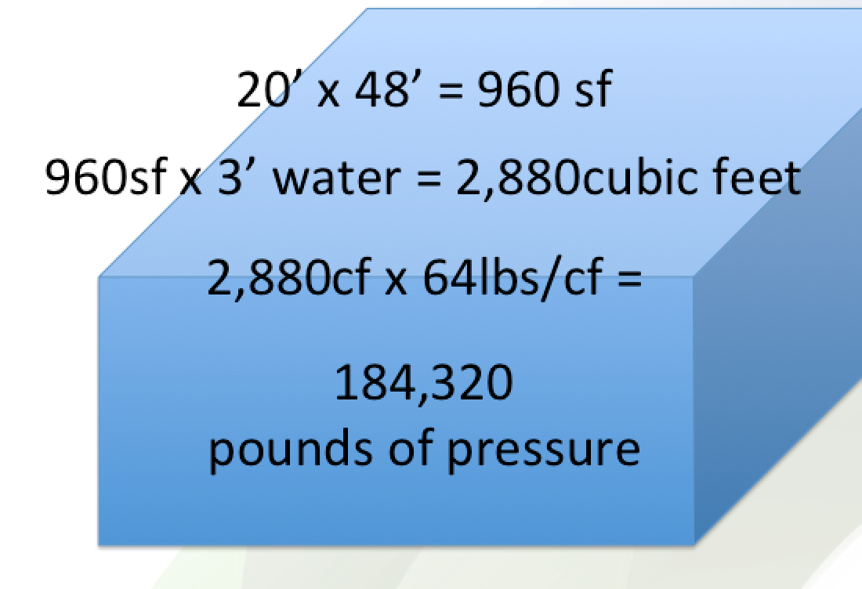
Navigating the Flood Insurance Program
Foundation Damage

Slide 42
http://skylineadjusters.com/practical-guide/
CROWNE PLAZA EXECUTIVE CENTER
4728 Constitution Avenue Baton Rouge, LA

Slide 43
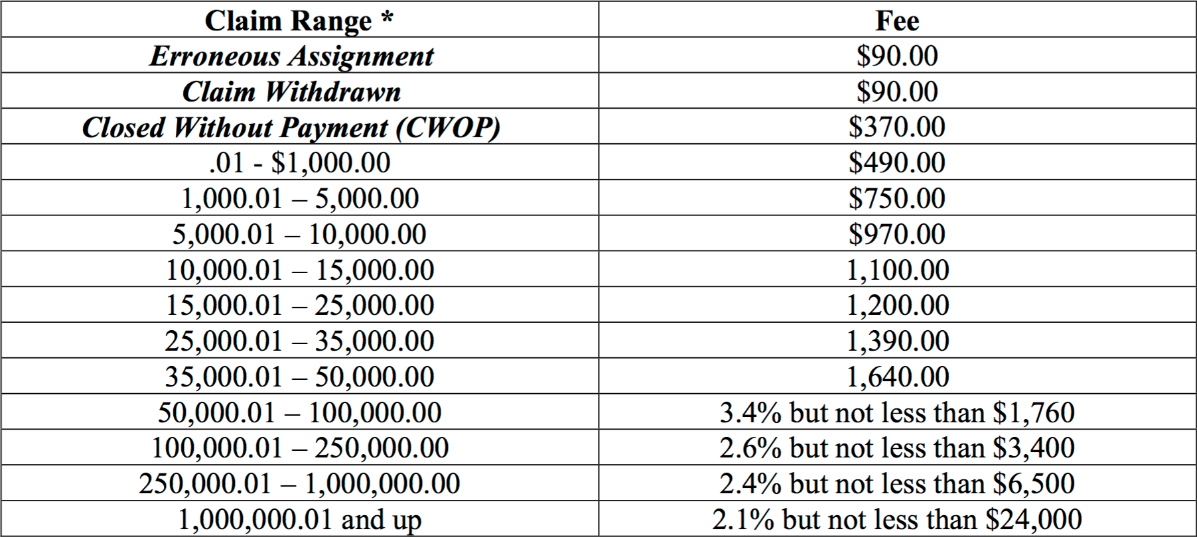
Navigating the Flood Insurance Program
“The more they pay the more they make”

Slide 44
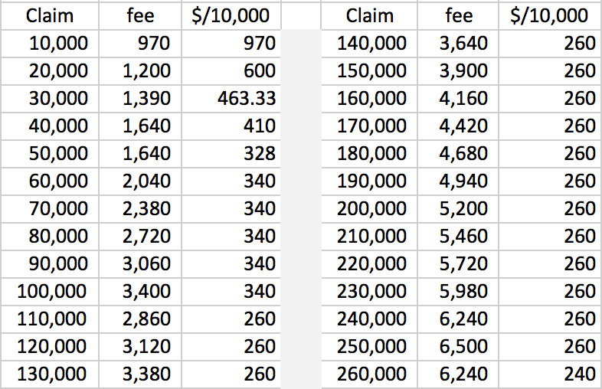
Navigating the Flood Insurance Program
“The more they pay the more they make”

Slide 45
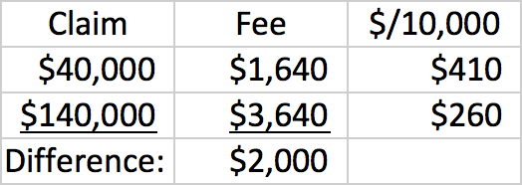
Navigating the Flood Insurance Program
“The more they pay the more they make”

Slide 46

Navigating the Flood Insurance Program
“The more they pay the more they make”
Adjusters are rewarded for Quantity not Quality

Slide 47
http://skylineadjusters.com/practical-guide/
CROWNE PLAZA EXECUTIVE CENTER
4728 Constitution Avenue Baton Rouge, LA

